Slide 1
CS F342
COMPUTER ARCHITECTURE

Slide 2
Outline
Performance
Program performance
Defining performance
Response time and performance
Relative performance
Execution Time Components
CPU clocking and performance

Slide 3
Performance
§1.6 Performance
Choose among different computers
Purchasers
Designers

Slide 4
Program Performance
Performance of a program depends on
Algorithm
Determines number of source level statements and I/O operations executed
Programming language, compiler, ISA
Determine number of machine instructions executed per source level statements
Processor and memory system
Determines how fast instructions are executed
I/O system (including OS)
Determines how fast I/O operations are executed

Slide 5
Defining Performance
Which airplane has the best performance?

Slide 6
Response Time and Throughput
Response time / execution time
time between the start and completion of a task
Individual computer user
Throughput / Bandwidth
Total work done per unit time
Datacenter managers
How are response time and throughput affected by
Replacing the processor with a faster version?
Adding more processors to a system that uses multiple processors for separate task?

Slide 7

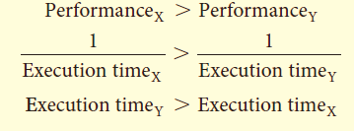
Response time & Performance
We’ll focus on response time for now…
1. To maximize performance, minimize response time or execution time
Let X and Y be computers
2. If the performance of X is greater than the performance of Y

Slide 8

Relative Performance
3. “X is n time faster than Y”

Slide 9
Relative Performance- example
Q: If computer A runs a program in 10 seconds and computer B runs the same program in 15 seconds, how much faster is A than B?

Slide 10
sol
Example: time taken to run a program
10s on A, 15s on B
Execution Time_{B} / Execution Time_{A} = 15s / 10s = 1.5
So A is 1.5 times faster than B

Slide 11
Relative Performance- example
Q: Computer C’s performance is 4 times as fast as the performance of computer B, which runs a given application in 28 sec. How long will computer C take to run that application?

Slide 12
sol
Example: time taken to run a program
28s on B
Performance_{c} = 4 Performance_{B}
Execution Time_{C} = Execution Time_{B} / 4 = 28s / 4 = 7s
So Execution time of C is 7s

Slide 13
Execution Time Components
Elapsed time / response / execution time
Total time to complete a task
Includes all aspects
Processing, I/O activity, memory access, OS overhead
CPU time
Time spent by processor to execute a job
Discounts I/O time, other jobs’ shares
User CPU time/CPU performance
CPU time spent in the user program
System CPU time
CPU time spent in the operating system performing tasks on behalf of the program

Slide 14
CPU Clocking
Operation of digital hardware is governed by a constant-rate clock
Clock period
Clock (cycles)
Data transfer and computation
Update state
Clock period: duration of a clock cycle
e.g., 250ps = 0.25ns = 250×10^{–12}s
Clock frequency (rate): cycles per second
e.g., 4.0GHz = 4000MHz = 4.0×10⁹Hz
Clock Period = 1/Clock Rate

Slide 15
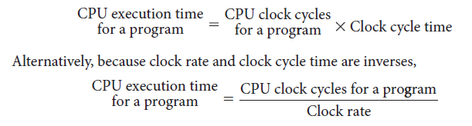
CPU Time (Performance)
Performance improved by
Reducing number of clock cycles
Increasing clock rate

Slide 16
CPU Time Example
Q: A program runs in 10 seconds on computer A, which has a 2 GHz clock. We are trying to help a computer designer build a computer, B, which will run this program in 6 seconds. The designer has determined that a substantial increase in the clock rate is possible, but this increase will affect the rest of the CPU design, causing computer B to require 1.2 times as many clock cycles as computer A for this program. What clock rate should we tell the designer to target?

Slide 17
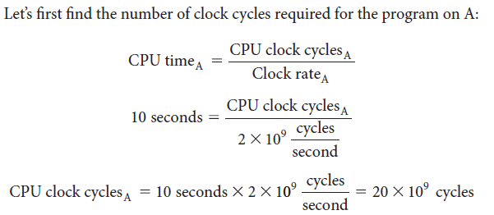
CPU Time Example

Slide 18
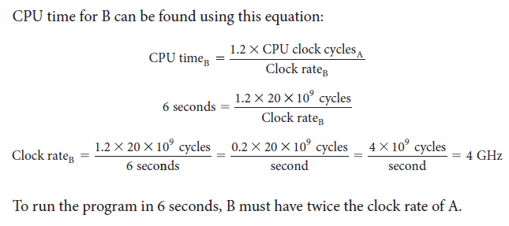
CPU Time Example

Slide 19
Instruction Count and CPI
Instruction Count for a program
Determined by program, ISA and compiler
Average cycles per instruction (CPI)
Determined by CPU hardware
Helps to compare two different implementations of the same instruction set architecture

Slide 20
CPI Example
Q: Suppose we have two implementations of the same instruction set architecture.
Computer A has a clock cycle time of 250 ps and a CPI of 2.0 for some program, and computer B has a clock cycle time of 500 ps and a CPI of 1.2 for the same program. Which computer is faster for this program and by how much?
Computer A: Cycle Time = 250ps, CPI = 2.0
Computer B: Cycle Time = 500ps, CPI = 1.2
Same ISA
Which is faster, and by how much?

Slide 21
CPI Example
Solution:
We know that each computer executes the same number of instructions for the program; let’s call this number I.
First, find the number of processor clock cycles for each computer

Slide 22
CPI in More Detail
If different instruction classes take different numbers of cycles

Slide 23


CPI Example
Q: A compiler designer is trying to decide between two code sequences for a particular computer. The hardware designers have supplied the following facts:
For a particular high-level language statement, the compiler writer is considering two code sequences that require the following instruction counts:

Slide 24
CPI Example
Which code sequence executes the most instructions?
Which will be faster?
What is the CPI for each sequence?

Slide 25
Check Yourself
A given application written in Java runs 15 seconds on a desktop processor. A new Java compiler is released that requires only 0.6 as many instructions as the old compiler. Unfortunately, it increases the CPI by 1.1. How fast can we expect the application to run using this new compiler?

Slide 26
Performance Summary
The BIG Picture
Performance depends on
Algorithm: affects IC, possibly CPI
Programming language: affects IC, CPI
Compiler: affects IC, CPI
Instruction set architecture: affects IC, CPI, T_{c}

Slide 27
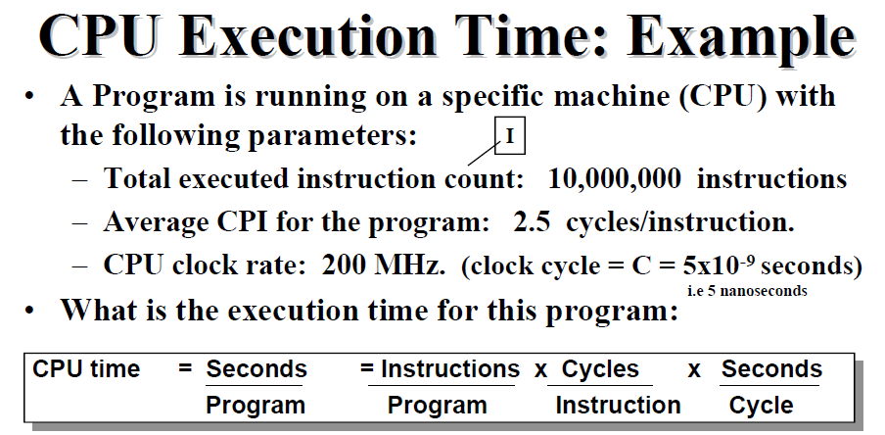
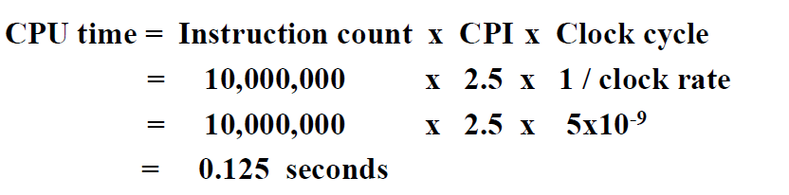
Example

Slide 28
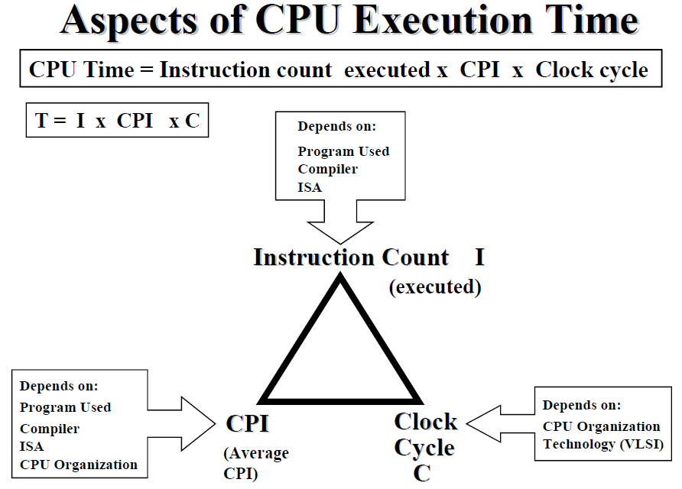
Example

Slide 29
Amdhal’s Law
Gene Amdahl, chief architect of IBM's first mainframe series and founder of Amdahl Corporation and other companies found that there were some fairly stringent restrictions on how much of a speedup one could get for a given parallelized task. These observations were wrapped up in Amdahl's Law
If F is the fraction of a calculation that is sequential, and (1-F) is the fraction that can be parallelized, then the maximum speed-up that can be achieved by using P processors is 1/(F+(1-F)/P).

Slide 30
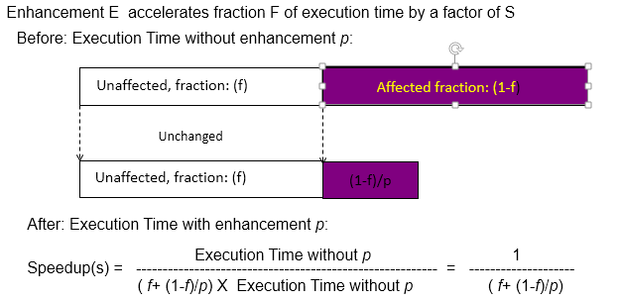
Amdhals’ Law

Slide 31
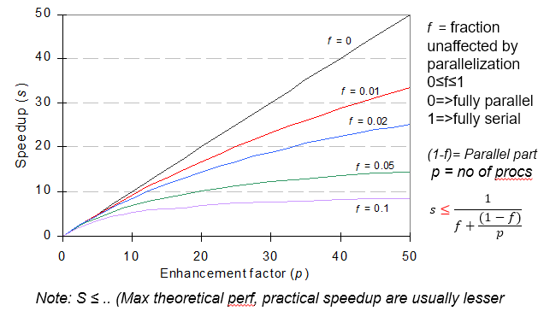
Amdhal’s Law

Slide 32
Amdhal’s Law (Eg.)
if 90% of a calculation can be parallelized (i.e. 10% is sequential) then the maximum speed-up which can be achieved on 5 processors is: ????
Ans: 1/(0.1+(1-0.1)/5) or roughly 3.6 (i.e. the program can theoretically run 3.6 times faster on five processors than on one)

Slide 33
Amdhal’s Law (Eg.)
if 90% of a calculation can be parallelized then the maximum speed-up on 1000 processors is
Ans: 1/(0.1+(1-0.1)/1000) or 9.9 (i.e. throwing an absurd amount of hardware at the calculation results in a maximum theoretical (i.e. actual results will be worse) speed-up of 9.9 vs a single processor).

Slide 34
Amdhal’s Law (Eg.)
20% of a program’s execution time is spent within inherently sequential code. What is the limit to the speedup achievable by a parallel version of the program?

Slide 35
Amdhal’s Law (Eg.)
A company replaces the existing processor in a database server, with a processor that is 10 times faster on the computation performed by the database server. It is found that 40% of total query execution time is spent on computation and rest on I/O operations. Find the overall speedup obtained, by the replacement of the processor

Slide 36
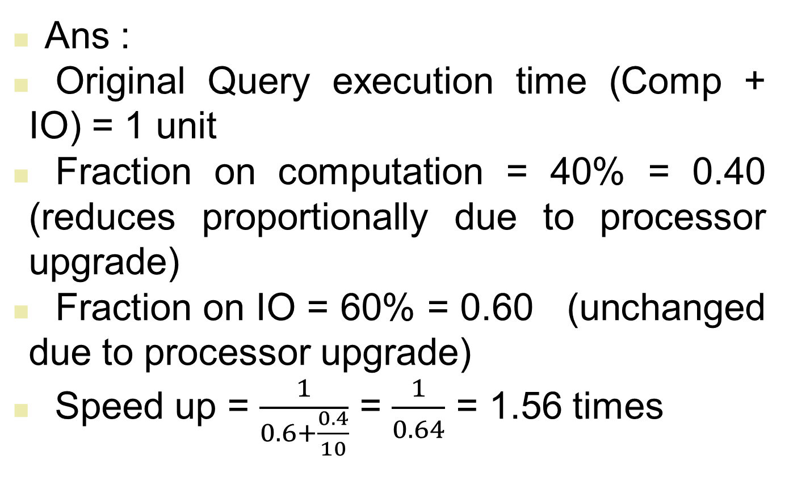
Ans :
Original Query execution time (Comp + IO) = 1 unit
Fraction on computation = 40% = 0.40 (reduces proportionally due to processor upgrade)
Fraction on IO = 60% = 0.60 (unchanged due to processor upgrade)
Speed up = $\frac{1}{0.6+\frac{0.4}{10}}$ = $\frac{1}{0.64}$ = 1.56 times

Slide 37
We are considering an enhancement to the processor of a web server. The new CPU is 20 times faster on search queries than the old processor. The old processor is busy with search queries 70% of the time, what is the speedup gained by integrating the enhanced CPU

Slide 38
We are considering an enhancement to the processor of a server. The new CPU 10X faster. I/O bound server, so 60% time waiting for I/O.

Slide 39
For a given program, the performance of computer A is 1.5 times faster than computer B. For the same program computer, A takes 20 seconds to execute, how much computer B takes to execute the program?
A program is executed on computer A and computer B. For both computers user CPU time and system CPU time is in proportion of 25% and 75%. The CPU time of computer B is 20 seconds and clock rate for computer B is 1.2 GHz. To execute same program, computer A takes twice clock cycles as that of computer B. Given clock rate of computer A is 2 GHz, what is the user CPU time for computer A?
Suppose computer A is having multitasking system. Many time computer A depends on resources located at server B, which is connected to computer A via network. Identify difference ways to increase throughput and response time for computer A and server B.

